Slide 1
SE Process – Software Configuration Management
PGCP

Slide 2
Module Overview (1)
Introduction of Software Configuration Management
Principles of Software Configuration Management
Software Configuration Management Organization
Software Configuration Management Planning

Slide 3
Module Overview (2)
Automation of Software Configuration Management
Configuration Management Process in Mitrais
Software Configuration Management Tool: Team Foundation Server (TFS)

Slide 4
Introduction of Software Configuration Management

Slide 5
Outline
The need for software configuration management.
Basic concepts of software configuration management.
Interaction with other IT processes.

Slide 6
Objectives
Describe the consequences when the discipline of configuration management is not in place.
Give an overview of the principles of the configuration management discipline.
Understand the main configuration management activities.
Explain the configuration management process model.
Explain the relations between configuration management and other IT support process.

Slide 7
Missing Configuration Management (1)
Executing activities based on incorrect or outdated documentation.
Updating the wrong version of a software component.
No stable test environment.
Reoccurrence of a problem in deployment solved before.

Slide 8
Missing Configuration Management (2)
Unknown versions of components at customer site.
Missing functionality because of incorrect merging activities.

Slide 9
Configuration Management (1)
Configuration management is a discipline applying technical and administrative direction and surveillance to:
identify and document the functional and physical characteristics of a configuration item,
control changes to those characteristics,
record and report change processing and implementation status.

Slide 10
Configuration Management (2)
Configuration management is based on the principle of immutability which implies the existence of versions, and provides mechanisms and techniques for the co-ordination of a team of people working together.
Notes:
Immutability : information frozen cannot be changed anymore

Slide 11
Software Configuration Management
Software configuration management is a supporting-software life cycle process that benefits project management, development and maintenance activities, quality assurance activities, as well as the customers and users of the end product.
Notes:
According to previous principle. Definition of software configuration management is…

Slide 12
Costs And Benefits
Proper performance of configuration management activities costs resources and time.
Highly dependent on :
The moment when configuration items are placed under configuration management,
The level of formality applied throughout the life cycle,
The total number of configuration items defined.

Slide 13
Basic Concept of SCM (1)
Environment Z
(e.g. Supplier)
Environment X
(e.g. Integrator)
Supply Components
Distribute Products
Environment Y
(e.g. Users)
Request Change
Request Delivery
Notes:
Environments Z represents internal or external suppliers of components (e.g. outsourced software, hardware, etc.),
Environment X the organization in which the components are integrated
Environments Y the environments to which the final product(s) are distributed and where they are used.

Slide 14
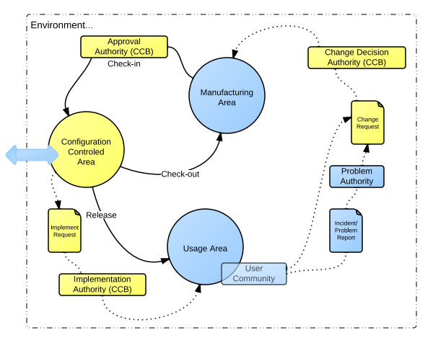
Basic Concept of SCM (2)
Notes:
Each individual environment can be structured as depicted in the figure Above
Within an environment the scope of Configuration Management is the set of activities related to the light yellow (or white) figures; the blue (or shaded) are outside the scope of configuration management.

Slide 15
Basic Concept of SCM (3)
Components designated for configuration management are denoted as configuration items.
Once an item is under configuration management it can be modified only by creating a new version.
A change to a version of a configuration item leads to a new version of the same configuration item.

Slide 16
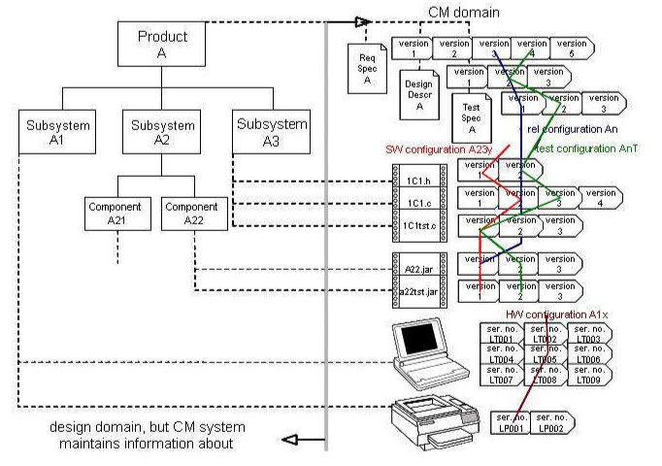
Example of Product Structure/CIs
Notes:
A product consists of subsystems and components. Once under control of configuration management the product equals the configuration and all its subsystems and components under configuration management are denoted as configuration items.
Example:
- Requirements Specification of the product A, the hardware item laptop, the C module 1C1.c in above figure is examples of configuration items.
- The document Design Description of the Product A exists in version 1 to 3, file 1C1.h exists in two versions and the hardware printer exists also in two versions (or instances).
- In order to test e.g. a subsystem, from all its constituent configuration items a version is needed. The same is true if the whole product is released for use.

Slide 17
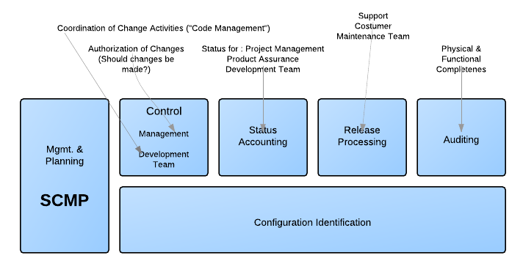
SCM Activities
Notes:
Chapter 2 explains these activities in more detail.

Slide 18
SCM Process Model
Configuration management is an event driven process.
It starts when:
An item needs to be controlled (at least for the planning and identification),
The item is ready to be placed under configuration management, when it is released for usage or a next phase,
Events are identified which leads to changes in the configuration, when information is needed, and when an audit needs to be executed.

Slide 19
Interaction With Other IT Processes
SCM does not produce anything in its own right.
SCM supports all basic IT phases (e.g. design, development, test and deployment).
SCM interacts with other support processes (e.g. project management, quality assurance/quality management, change management, release management, etc.)

Slide 20
SCM on Management Levels
The higher level management is responsible for:
Definition of overall purpose and structure,
Associated resource allocation,
General specifications and standardizations.

Slide 21
SCM in Engineering Process
SCM supports all engineering processes, from requirements definition and management, through design, coding, and test to installation.
Example: SCM Plan

Slide 22
SCM Related to Deployment Process
SCM provides a reference to all important descriptive information and the product constituents.
The controlled area is the bridge between deployment and engineering.
Notes:
Example: when creating build, SCM provides requirements, designs, work items (including their versions) that are associated with the builds.

Slide 23
SCM Related to Other Process
SCM also supports project management, quality assurance, requirements management, and document and asset management.
Products being produced and maintained by these process areas should be placed under configuration management.
Notes:
Example: Reports, test plans should be versioned and put under cm.

Slide 24
SCM in Relation to External Parties
SCM to support external parties like outsourcing, deployment by external agencies, contractors.
Example: should agreements contain elements towards product delivery like which components are delivered, and how later deliveries are handled?

Slide 25
SCM Related to Process Improvement
SCM two different relations to process improvement:
A support process for process improvement
The subject for process improvement
Notes:
Configuration management is a support process for process improvement, that is for products being produced and maintained by those responsible for process improvement, for example a methodology department. These products could be process descriptions, standards, templates, technique descriptions, and tools. The process improvement staff should perform configuration management on the products they are responsible for.
Setup and constantly improving a configuration management system should be the responsibility of process improvement.

Slide 26

Question

Slide 27
Principles of Software Configuration Management

Slide 28
Outline
Configuration Identification
Configuration Item Storage
Software Configuration Control
Configuration Status Accounting
Software Configuration Auditing
Release

Slide 29
Objectives
Understand and explain the criteria for defining configuration items.
Explain the principles of storage.
Understand Configuration change control process and the life cycle of change requests.
Recognize the role of status accounting and reporting within configuration management.
Understand to the distribution of a software configuration outside of the development activity

Slide 30
Introduction
SCM Definition in ANSI/IEEE Std. 610.12-1990 :
The discipline of applying technical and administrative direction and administration to:
identify and document the functional and physical characteristics of a configuration item,
control changes to those characteristics,
record and report change processing and implementation status,
verify compliance with specified requirements.

Slide 31
Configuration Item (1)
The main subject of configuration management activities.
A configuration item is an aggregation of hardware, software or both that is designated as a unit for configuration management, and treated as a single entity in the configuration management process.

Slide 32
Configuration Item (2)
Examples of configuration items are:
Software component
Support software item
Baseline
Release
Document
Notes:
software component, such as a version of a source module, object module, executable program or data file,
support software item, such as a version of a compiler or a linker,
baseline, such as a software system under development,
release, such as a software system in operational use,
document, such as an Architectural Design Document.

Slide 33
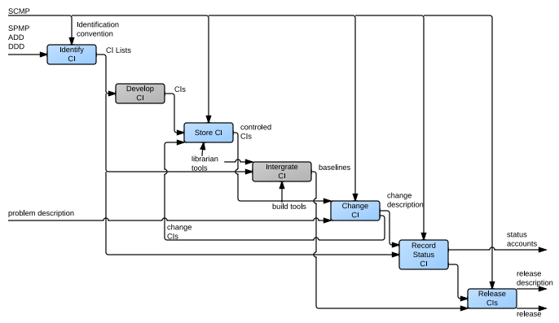
SCM Activities
Notes:
The relationship between the software configuration management activities (blue) and component development, system integration and build activities (grey).

Slide 34
Software Configuration Identification
Software configuration identification identifies items to be controlled, establishes identification schemes for the items and their versions, and establishes the tools and techniques to be used in acquiring and managing controlled items.

Slide 35
Software Configuration Identification
Input: Software Project Management Plan (SPMP), the Architectural Design Document (ADD) and the Detailed Design Document (DDD).
Output: a configuration item list.
Configuration identification conventions should state how to:
Name a CI;
Who is the control authority of a CI;
Describe the history of a CI.
Notes:
SPMP : lists the project documents
ADD , DDD : list the software components
For example an SPMP will say that a Software Requirement Document will be written, but the configuration item list will define its file specification.

Slide 36
What To Identify As CIs
Several factors may be relevant in deciding what to identify:
Software design defined in the ADD and DDD.
Capabilities of the software development tools (e.g. the units that the compiler or linkers input and output);
Bottom-level work packages defined in the SPMP.
Notes:
A configuration item (CI) is an item or aggregation of hardware or software or both that is designed to be managed as a single entity. A software configuration item (SCI) is a software entity that has been established as a configuration item.

Slide 37
Baseline
A software baseline is a formally approved version of a configuration item (regardless of media) that is formally designated and fixed at a specific time during the configuration item’s life cycle.

Slide 38
Baseline
A CI that has been formally reviewed and agreed.
Declared a basis for further development.
Must be consistent each other. Example:
Code configuration items are compatible with the design document configuration items,
Design document configuration items are compatible with the requirements document configuration items,
User manual configuration items describe the operation of the code configuration items.

Slide 39
Variant
Refer to “although offering almost identical functionality, differ in several aspects such as, hardware environment, communications protocol, user language”

Slide 40
How to Identify CIs
Each configuration item must possess an identifier to ease traceability.
It should contain: the name, type and version.
Type : source CIs, derived CIs, Tools.
Version <> Revision.
Notes:
Version numbers allow changes to configuration items to be distinguished. Whenever a configuration item is changed.
Revision numbers track minor changes that do not change the functionality, such as bug fixes. When this approach is used, the version number actually consists of two numbers. The first marks major changes and the second, the revision number, marks minor changes. For example a software release might be referred to as ‘Version 5.4'. For documents, the first number is called the ‘issue' number. A version of a document might be referred to as ‘Issue 2 Revision 1', for example.

Slide 41
CI History
Must be recorded from the moment it is first submitted for review or integration.
Notes:
For documents, this history is stored in Document Change Records (DCRs) and Document Status Sheets (DSS). For source code, the development history is stored in the module header. Change records in module headers should reference the Software Change Request (SCR) that is actioned them. For derived code, the development history is stored in the librarian's database.

Slide 42
CI Attribute: Relationships
A CI has types of relations : build-, dependency-, breakdown-, impact- relations.
The relationship between CIs are registered in Traces.
Notes:
Structural relationships among the selected SCIs, and their constituent parts, affect other SCM activities or tasks, such as software building or analyzing the impact of proposed changes. Proper tracking of these relationships is also important for supporting traceability.
Example of Traces : all design objects and test procedures from individual requirements are examples of forward traces whereas references from individual design objects and test procedures to the requirements implemented and tested by these are examples of backward traces

Slide 43
CI Attribute : Authorization and Distribution
May derived from the configuration management plan, the project plan or a quality plan.
Example of authorization: descriptions of responsibilities for the production, delivery, and the acceptance for various types of Cis.
Example of distribution: Unique identification of delivered items, the area and/or persons receiving the delivery and the date of delivery

Slide 44
CI Storage – Software Libraries
A software library is a controlled collection of software and related documentation designed to aid in software development, use, or maintenance.
As a minimum, every project must use the following software libraries to store configuration items:
Development (or dynamic) libraries;
Master (or controlled) libraries;
Archive (or static) libraries.
Notes:
Development libraries store configuration items that are being written or unit tested. Maintained by the software authors in their own work space. Master libraries store configuration items in the current baselines. Created and maintained by the software librarian
Archive libraries store configuration items in releases or retired baselines. Configuration items in archive libraries must not be modified. Created and maintained by the software librarian

Slide 45
CI Storage – Media Control
All configuration items should be stored on controlled media (e.g. tapes, disks).
Must be labeled, should have a standard format and contain:
Project name,
Configuration item identifier (name, type, version) ,
Date of storage,
Content description.

Slide 46
Software Configuration Control
Software configuration control is concerned with managing changes during the software life cycle.

Slide 47
Software Configuration Control
The handling of changes to configuration items has three aspects:
Requesting, Evaluating, and Approving Software Changes
Implementing Software Changes
Deviations and Waivers

Slide 48
Cause for Changes
The initiator is the occurrence of an event.
An event must be registered if it pertains one or more CIs.
Events can be raised by all stakeholders within the organization or at customer’s.
Notes:
An event could be anything varying from a simple incident during deployment or validation tests to a new business need for adapting the product for commercial or regulation reasons. These initiators come in many variations and have many aliases, such as anomalies, bugs, problems, deviations, failures, enhancements, waivers, and incidents.
The event registration must be done meticulously so that the origin of the event can be understood and followed by stakeholders, recreated, investigated, and decided upon by the appropriate CCB, and monitored to confirmation of solution or implementation.

Slide 49
Configuration Control Board
It is a group of technical and administrative experts with the assigned authority and responsibility to make decisions about changes to configuration items.
The CCB discusses events and makes decisions about what is going to happen.
If an event leads to one or more changes to configuration items, these changes must be recorded as formal requests (e.g. Request for Change).
Notes:
In Figure 2 the different authority boards are implementations of CCB’s.
CCB members can perform the analysis of event themselves or they can request analysis reports from experts. The analysis must include an impact analysis based on attributes, design documents, possible related events with associated solutions, test reports and other information about the product and project. The analysis should consider the cost of implementing changes compared to the cost of not implementing these changes.

Slide 50
Change Life Cycle
A change request should be issued for each configuration item affected by an event.
Close out of a change request can only be done with approval of the person responsible for the configuration item being changed.
Notes:
It is up to the organization to decide the number of states.

Slide 51
Implementing Software Changes
Approved SCRs are implemented using the defined software procedures in accordance with the applicable schedule requirements.
Changes may be supported by source code version control tools. These tools allow a team of software engineers, or a single software engineer, to track and document changes to the source code.

Slide 52
Deviations and Waivers
A deviation is a written authorization, granted prior to the manufacture of an item, to depart from a particular performance or design requirement for a specific number of units or a specific period of time.
A waiver is a written authorization to accept a configuration item or other designated item that is found, during production or after having been submitted for inspection, to depart from specified requirements but is nevertheless considered suitable for use as-is or after rework by an approved method.

Slide 53
Configuration Status Accounting (1)
The recording and reporting of information needed to manage a configuration effectively.
It includes:
A listing of the approved CIs,
The status of proposed changes to the configuration, and
The implementation status of the proposed changes
Notes:
See figure 6

Slide 54
Configuration Status Accounting (2)
Maintained by Software Librarian.
Examples: release notes, item status lists, item history lists, configuration composition lists, change request status reports, change trace reports, and audit reports.
Notes:
Configuration status accounts are important instruments of project control, and should be made available to all project members for up-to-date information on baseline status. When a program works one day and not the next, the first question is ‘what has changed?'. The configuration status accounts should answer such questions quickly and accurately. It should be possible to reproduce the original baseline, verify correct operation, and individually reintroduce the changes until the problem recurs.

Slide 55
Software Configuration Auditing (1)
A software audit is an independent examination of a work product or set of work products to assess compliance with specifications, standards, contractual agreements, or other criteria

Slide 56
Software Configuration Auditing (2)
Two types of formal audits might be required by the governing contract (for example, in contracts covering critical software):
The Functional Configuration Audit (FCA)
The Physical Configuration Audit (PCA)
Notes:
FCA: The purpose of the software FCA is to ensure that the audited software item is consistent with its governing specifications. The output of the software verification and validation activities is a key input to this audit.
PCA: The purpose of the software physical configuration audit (PCA) is to ensure that the design and reference documentation is consistent with the as-built software product.

Slide 57
Release (1)
The formal distribution of an approved version.
It is assembled or built from existing configuration items.
It may be considered a new version of a configuration, and be placed under configuration control.

Slide 58
Release (2) – Software Building
Software building is the activity of combining the correct versions of software configuration items, using the appropriate configuration data, into an executable program for delivery to a customer or other recipient, such as the testing activity

Slide 59
Release (3) – Software Release Management
Software release management encompasses the identification, packaging, and delivery of the elements of a product—for example, an executable program, documentation, release notes, and configuration data.

Slide 60

Question

Slide 61
Software Configuration Management Organization

Slide 62
Outline
Configuration Management Roles and Responsibility.
Person Behind Configuration Management.
Configuration Management Influence

Slide 63
Objectives
List and Explain the different roles in configuration management.
Understand the responsibilities of the mentioned roles.
Recall that the success of configuration management is influenced by psychological factors.

Slide 64
SCM Roles and Responsibility (1)
Roles based on the activities:
roles for the implementation and maintenance of the CM system.
roles for planning the activities using the CM system.
roles for creating and updating the CM information,
roles for auditing the CM information,
and roles that are solely using/supplying CM information.

Slide 65
SCM Roles and Responsibility (2)
The classic names used for these roles in configuration management are:
Configuration management sponsor
Configuration manager
Configuration management librarian
Configuration Control Board (CCB)
Notes:
Configuration management sponsor: has the responsibility for the overall planning, implementation, maintenance, and improvement of CM within the framework (policy/strategy) provided by management.
Configuration manager: responsible for planning, monitoring and controlling the configuration management for at least one specific domain/configuration.
Configuration management librarian: responsible for establishing and maintaining the configuration management system(s), for the maintenance of each controlled area(s), their internal integrity, and integrity between areas. The holder of this role can also have the responsibility for the technical implementation, administration and usage of supporting tools within the configuration management process.
Configuration Control Board (CCB): the overall responsibility for control of the individually defined configuration items and the configuration.

Slide 66
SCM Roles and Responsibility (3)
It does not have to be a fulltime job.
they may be filled by a person who also has other areas of responsibility.
However, if a role takes only a small portion of a person’s available time, there is a risk due to prioritization of tasks that the role is not or only partly executed.

Slide 67
Person Behind Configuration Management
Configuration management is a discipline in progress.
Appealing for people with following mindset:
a strong sense for structure and control.
appreciates that the process delivers the central nerve system of product development.
ability to communicate with many different people.
and (perhaps most importantly) ‘faith’ in configuration management as a discipline.
Notes:
Currently the possibilities for education with regard to configuration management are less than for areas like project management and test management. Configuration management as a career path must be strengthened.

Slide 68
Configuration Management Influence
Configuration management has an influence on the following areas:
Roles in the organization not directly active in configuration management but benefiting from it.
Roles active in development and design phases though not directly executing a configuration management role.
If an organization makes use of external units (contractors) the external roles are also influence by configuration management.
The product customer side.
Notes:
Example be management responsible for assets, responsible for deployment and operations, responsible for process improvement, responsible for environments and tools; and support/helpdesk. Improper implementation of configuration management has a negative influence on the performance of these roles.
Examples are analysts, designers, developers, integrators, testers, project managers, and the QA responsible.
In most of the contracts with external parties configuration management aspects must be dealt with (e.g. method of distribution and/or releasing, internal configuration management).
Failing configuration management could have an influence on the final quality of the product. The customer being a business unit outside the IT is not involved in any configuration management activity during development, but might be affected by the negative consequences of bad configuration management.

Slide 69

Question

Slide 70
Software Configuration Management Planning

Slide 71
Outline
Software Configuration Management Plan
Monitoring and Planning

Slide 72
Objectives
Understand the need and the purpose for a policy within an organization.
Summarize the purpose and content of a CM plan.
Identify pitfalls in implementing configuration management.

Slide 73
SCM Plan (1)
The planning of an SCM process for a given project should be consistent with the organizational context, applicable constraints, commonly accepted guidance, and the nature of the project (for example, size, safety criticality, and security)
Notes:
Configuration management can be implemented with different scopes, such as organizational level, product level (e.g. an application) or project-level (e.g. a release of an application), and/or for one or more phases of a product life cycle. The scope and objectives of the plan vary accordingly.
The major activities covered are software configuration identification, software configuration control, software configuration status accounting, software configuration auditing, and software release management and delivery. In addition, issues such as organization and responsibilities, resources and schedules, tool selection and implementation, vendor and subcontractor control, and interface control are typically considered. The results of the planning activity are recorded in an SCM Plan (SCMP), which is typically subject to SQA review and audit.

Slide 74
SCM Plan (2)
The results of SCM planning for a given project are recorded in a software configuration management plan (SCMP).
A “living document” which serves as a reference for the SCM process.
It is maintained (that is, updated and approved) as necessary during the software life cycle.

Slide 75
SCM Plan (3)
It must be in place.
It should be easy to follow.
(Whenever possible) It should be reusable in later phases.

Slide 76
SCM Plan (4)
Six categories of SCM information to be included in an SCMP:
Introduction (purpose, scope, terms used)
SCM Management (organization, responsibilities, authorities, applicable policies, directives, and procedures)
SCM Activities (configuration identification, configuration control, and so on)
SCM Schedules (coordination with other project activities)
SCM Resources (tools, physical resources, and human resources)
SCMP Maintenance.

Slide 77
Configuration Management Policy
It is the written document containing the organizational position towards CM.
It should include:
A definition of CM.
The activities to perform.
The quality goals of CM.
The approach of improvement.
Authority and compliances.

Slide 78
Pitfalls of CM Implementation (1)
Starting without an approved plan,
Starting too late in the life cycle,
Unaccepted discipline, no commitment, no understanding in the organization,
Underestimating the organizational impact/change,
Not enough resources or resources with conflicting responsibilities,

Slide 79
Pitfalls of CM Implementation (2)
Legacy CM systems kept alive for the wrong reasons,
No formal role descriptions for CM roles; no career possibilities,
Lack of specific CM skills,
Considering tools as the answer for all CM problems.

Slide 80
Monitoring and Planning
An important aspect of monitoring and reporting is
Metrics : define what to measure.
Measurements : provide the management and the involved people with information.
Notes:
The execution of a configuration management plan should follow a normal planning cycle (e.g. plan – do – check - act).

Slide 81
Monitoring and Planning
Some useful metrics are:
Number of configuration items under control
Number of customer requests raised/implemented
Number of fixed problems per product/configuration item/release/build
Number of problems after a release
Number of changes to a module/configuration item
Average time to implement fixes
Average time to change a module

Slide 82

Question

Slide 83
Automation of Software Configuration Management

Slide 84
Outline
Selecting Configuration Management to Automate.
Common Features of Software Configuration Management Tools.
Automation Project/Implementation of Tools

Slide 85
Objectives
Identify the areas and activities to be automated.
Understand common features in SCM tools.
Understand the process of an implementation.

Slide 86
CM Activities to be Automated (1)
Administration of configuration items.
Administration of change proposals and change requests during their life cycles;
Storage and identification of items and their versions;
Build and integration;
Release of digital items;
Reporting;
Supplying configuration management metrics.

Slide 87
CM Activities to be Automated (1)
Some consideration:
Choosing too many activities to be automated in one go can be very difficult to manage and implement;
Choosing too few activities could result in duplication of work;
Choosing too few activities at the time, so that the overall implementation will take longer, makes employees and management wary of the changes to come.

Slide 88
Common Features of SCM Tools
Version Control
Worksheet Management
Concurrency Control
System Building

Slide 89
Version Control
The main purpose is to manage different versions of configuration objects that are created during the software engineering process.
Building can be done for a subsystem, a module, or a whole system.
The building strategy can be either incremental or from scratch.
Notes:
In incremental building, only files that been changed will be built; correspondingly, all files will be built when building from scratch. Building from scratch can be a very expensive process in terms of machine resources, because a large system may contain thousands of files of source code.

Slide 90
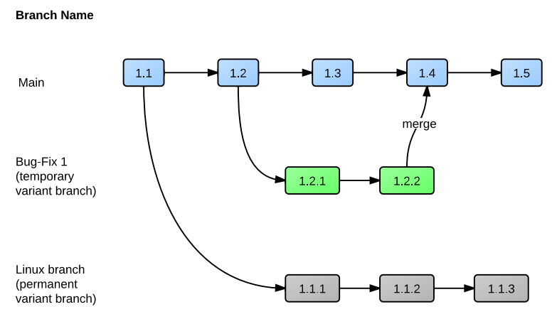
Basic Version Control
Notes:
Figure 7 presents a situation where development is done in parallel branches. When revision 1.3 is almost done, revision 1.2, which is already in use at a customer site, is noticed to have a bug. If there is no time to wait for revision 1.3 to be approved, a temporary bug-fix branch is created, the bug is fixed, and the variant is supplied to the customer. After that version 1.3 and 1.2.2 are merged into version 1.4. At the same time, development is also done in a permanent variant branch for Linux.

Slide 91
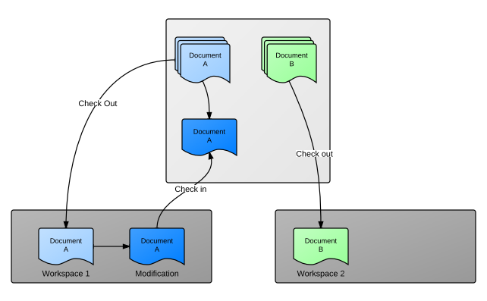
Workspace Management
The purpose is to prevent users from interfering with one another's work.
Notes:
Developers can check out desired files or configuration from the repository in their own workspaces. The “check out” operation creates copies of the items in the developer's workspace; after that, the developer can modify the items as needed and finally execute “check in”. The “check in” operation copies items back into the repository: the version control system then creates new versions as needed. Figure 8 represents the check-out/in process. A “get“ operation equals to a “check out” operation, except that the files copied into the workspace are read-only and therefore cannot be modified. The terminology in use for these operations can vary between different SCM tools.

Slide 92
Concurrency Control
Optimistic concurrency control: the files are not locked therefore there may be simultaneous modifications to the same files by multiple users.
Prevent simultaneous access by using a locking mechanism.
Notes:
The advantages of concurrent development are remarkable. Development teams can work with the same files, while the SCM tool controls development. The difference between concurrent and parallel development is that in concurrent development, branches are finally merged into a single item, whereas in parallel development merging is not performed and branches go ahead separately. The same alternatives can exist at the project level. For example, if there is a project that reaches the testing stage, the project can be branched so that testing and bug fixing can be performed separately. Development continues in the main branch, and later on the modified files on these two branches can be merged.

Slide 93
System Building
The purpose is to combine needed file versions and then compile them to create an application.

Slide 94
Selecting Tool(s)
Automation without a clear project management approach is doomed to fail.
The tool(s) to implement must be selected or developed based on the requirements.
Remember: A fool with a tool is still a fool
Notes:
Automation can be achieved via
commercial software (i.e. COTS),
open source tools,
software already in use within an organization (e.g. to be adapted to newer situations),
internally developed software
be spoken software developed by a supplier.

Slide 95
Implementation Process
The implementation process is for the introduction of the tool(s) in the organization.
A project must be set up to implement the tool(s).
An implementation approach must be defined.
Proper training and motivation must be conducted
Notes:
A project must be set up to implement the tool(s). This includes all the standard project aspects like budget, time, quality and resource. An automation project starts with an implementation plan, management commitment, and involvement of key people. Commitment from management and sufficient resources are pre-requisites for a successful implementation.
An implementation approach must be defined. This includes possible tailoring of tool(s), pilot, internal communication, phasing of implementation, training and coaching, and ongoing administration and maintenance during deployment.

Slide 96
Question

Slide 97
Configuration Management Process in Mitrais

Slide 98
Outline
Workflow
Entry Criteria
Formats & References
Tasks
Measurement
Review and Audit
Exit Criteria

Slide 99
Objective
Understand how the general concept of SCM is implemented at Mitrais.

Slide 100
Purpose of SCM in Mitrais
To establish and maintain the integrity of work products using configuration identification, configuration control, configuration status accounting, and configuration audits.

Slide 101
Entry Criteria
Several entry criteria which currently identified within Mitrais organization.
Project started
Product acquired
Inception project started
New work product introduced
CIs approved
Request to deliver work product for review or final delivery
Change request raised
Periodic backup dues
Project QA Audit schedule dues
Project warranty is over

Slide 102
Workflow

Slide 103
Task - Plan CM System
Prepared by Project Manager or Configuration Manager.
For smaller project, it is included in Software Development Plan (SDP).

Slide 104
Task - Manage Change Request
Activities:
Log change requests in the Change Request Log.
Carry out impact analysis.
Get the approval from CCB.
If the change is approved,
check out the CIs.
Prioritize the change.
Carry out appropriate changes in the CIs.
check in the CIs into the baseline directory with a new version number.
Report the status of the change request (implemented or rejected)
Update the Change Request Log.

Slide 105
Task - Identify and Baseline CIs
Suggested numbering structure “M.nn”:
M: the major version number, incremented when there is change in the base environment or a major change in the functionality.
nn: the minor changes.
Convention:
Document:
[Client Name] [Project Name] [Product Version] [Document type] [document version].doc
e.g.: PTMI_INCOMedicalSystem_2.10_SRS_1.10.doc
Product baseline:
[Product Version] [Build Number] [Baseline Tag at Version Control]
e.g.: 2.10-B19-200401281319

Slide 106
Task - Manage Configuration Status (1)
The objective is to maintain a continuous record of the status of all baselined items.
It is done by maintaining a document that contains a master list of all baselined CIs.

Slide 107
Task - Manage Configuration Status (2)
The activities in management configuration status are:
Make an initial entry when a CI is baselined for the first time.
Update when the status of the CI changes after approval based on the change control process.
Print the configuration status report, if required.
The Master list need not have an individual entry for code files. The location of code where the baselined version exists needs to be mentioned.

Slide 108
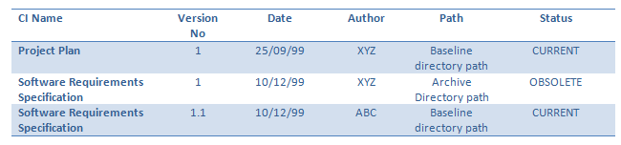
Task - Manage Configuration Status (3)
Example SCM Master List:

Slide 109
Task - Configuration Audit
Generally conducted as a part of SQA Audits.
Areas are to be audited:
All software releases.
All updates to baselined documents.
All approved change requests.
Notes:
areas are to be audited:
All software releases must be controlled to ensure the accuracy of the change implementation and continued integrity of the CI.
All updates to baselined documents are audited to ensure accuracy and continued integrity of the documentation set.
All approved change requests are audited upon incorporation to ensure accuracy and integrity of the documentation set as well as the software build.

Slide 110
Task - Release CI
Release is taking a snapshot of current version of CIs for delivery or review purposes.
The activity will include getting the current version of CIs and packing into delivery package.

Slide 111
Task - Establish Configuration System
The basic activities are:
Provide the infrastructure for project repository,
Identify the CIs,
Baseline the CIs and
Update the configuration status at the first time.
It is performed at the initial phase of the project.

Slide 112
Task - Backup and Archive Process
Takes current snapshot of project repository into the backup media.
Generally conducted as a part of ITS backup and archive continuous procedure
Notes:
However if required, the Project Manager may commission backup and archive process over and above ITS standard process. This shall be defined in the Configuration Management Plan.

Slide 113
Task - CM Closure
This activity releases or freezes any resources utilized by CM process during the project.
Some typical resources that should be released or terminated include:
The user access to project repository
Archive process
Destroy any obsolete and sensitive document

Slide 114
Measurement
Measurements of SCM processes provide a good means for monitoring the effectiveness of SCM activities on an ongoing basis.
These measurements are useful in characterizing the current state of the process as well as in providing a basis for making comparisons over time.
Notes:
Analysis of the measurements may produce insights leading to process changes and corresponding updates to the SCMP.

Slide 115
Exit Criteria
Configuration Management system is in place .
CIs identified and baselined.
Configuration status list updated.
Closed or rejected Change Request.

Slide 116

Question

Slide 117
Software Configuration Management Tool: Team Foundation Server

Slide 118
Outline
Introduction
Elements of Team Foundation Server
Team Foundation Version Control and Work Items

Slide 119
Objectives
Understand version control mechanism in TFS.
Understand fundamental operations in TFS.

Slide 120
Introduction
SCM Tools types:
Standalone SCM applications do not talk to other SCM applications.
Integrated change management toolkit.
SDLC tool suite.
Notes:
1. it can be difficult for development team members to associate the configuration items. E.g. it can be difficult for development team members to associate the configuration items.
2. enables team members to associate work items with source-controlled files.
3. SDLC tool suites represent a comprehensive approach to software configuration management and often impose SCM discipline on all aspects of the development life cycle. include specialized tools and features for each functional area of a software development team, from architecture to development to documentation, as well as tools such as work item tracking and source code control applications for vital change management tasks.

Slide 121
Objectives
Introduce one of the SCM Tools used in Mitrais
Understand Work Item concept in Team Foundation Server.
Understand Basic Operations of Team Foundation Server.
Understand Branching and Merging Operations.

Slide 122
Team Foundation Server
Classified into the third type.
A collaboration platform at the core of the Visual Studio solution for application lifecycle management.
Provides fundamental services such as version control, work item and bug tracking, build automation, and a data warehouse.

Slide 123
Elements of Team Foundation Server
Team Foundation are integrated change management components, they are:
Project Management.
Version Control.
Work Item Tracking.
Team Building.
Data Collection and Reporting.
The Project Portal.
Shared Services.
Notes:
Project Management : Using work item tracking to monitor a project’s process and health. Using process template mechanism to define a set of instructions for setting up a new project, including such items as work item types, project roles and permissions, a set of pre-populated tasks to act as a project roadmap, document templates, and report definition.
Version Control : Team Foundation Server includes an industrial-strength version control system that targets enterprise source control requirements. It has standard version control mechanisms for check-in, check-out, version management, and diff/merge.
Work Item Tracking : It is used to store and assess bugs, requirements, scenarios, tasks, and any other sort of work item you choose to monitor.
Team Building : TFS augments the MSBuild engine with Team System-specific tasks such as automated testing, determining code churn, and updating work items.
Data Collection and Reporting : Data persisted by Team Foundation Server tools is stored in SQL Server databases on the data tier. Each tool includes a warehouse adapter that pulls data from its normalized operational tables, and into a data warehouse used for analytics and reporting. These include a variety of reports that cut across tools and projects: bug trends, test coverage, code churn, and so on.
Project Portal : When a team project is created using the Project Creation Wizard, a Windows SharePoint Services site is instantiated on the application tier. The site acts as a portal for the team project.
Shared Service : The Team Foundation Server architecture rests on a set of shared services that are designed to simplify extensibility.

Slide 124
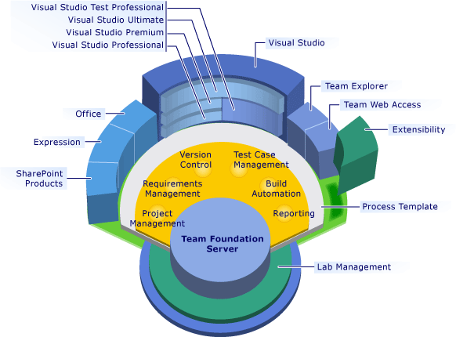
Visual Studio Platform

Slide 125
TFS Work Item
A record in database table
The mechanism for tracking
Work
Defects
May be very different per Team Project.
Customizable
Per Team Project
Before or after the project is created

Slide 126
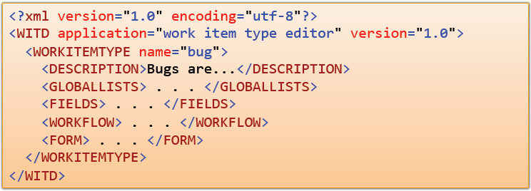
TFS Work Item - Types
Each work item described in the process template using XML

Slide 127
TFS Work Item – Contain (1)
Fields
Contain information about the work item
Title, Dates, Description, Etc.
Field Rules
Constraints for what a fields contain
For example, the values that are supported in a field
Display Rules
Controlling how fields are displayed
Team Explorer
Team Web Access

Slide 128
TFS Work Item – Contain (2)
Simple State Transition Model
Require or prohibit fields values
At different points during the work item’s life cycle
Not a sophisticated workflow system
Your Data
As a record in a database
Constrained to the Work Item definition

Slide 129
TFS Work Item Demo
Show Agile User Story
Show the Task
Show WI Relationships
Areas and Iteration
State Transition Diagram
WI Queries
WI Alerts

Slide 130
Version Control - Common Model
Checkout/Edit/Check in
Files are checked out from a central server, edited and then checkedin.
Team Foundation Server, Source Safe, Perforce, SourceGear Vault.
Edit/Merge/Checkin
Files are edited without notifying the server and merged when checked in to a central server.
Subversion, CVS, SourceGear Vault (in ‘CVS’ Mode
Distributed Edit/Merge/Checkin
Files are edited without notifying the server and then submitted to a local server. The local server can push and pull content from remote server.
Git, Mercurial, Bitkeeper, Bazaar

Slide 131
Version Control - Workspace
The container that bridges the gap between your local computer and the Team Foundation Server repository
Identified by a name and the hostname of the computer the workspace is for.
Contains: the working folder mapping, the state of workspace stored on the server (e.g. files version and files that are being changed).

Slide 132
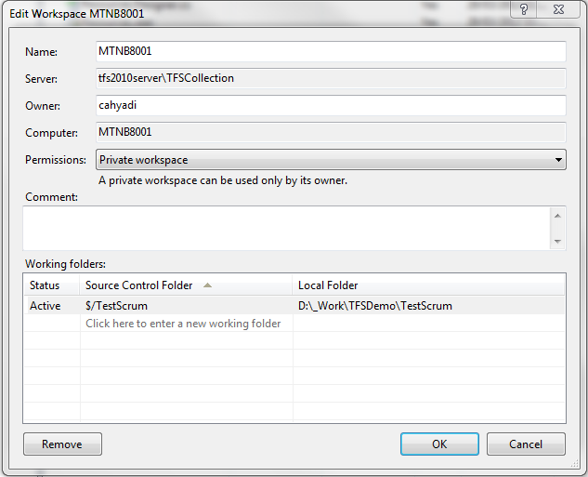
Version Control – Working Folder
Which folders on your local machine map to which folders in the repository.

Slide 133
Version Control Demo (1)
Connecting to TFS
Browsing TFS
Creating a workspace
Setting up working folder

Slide 134
Version Control - Get
Download the files from the repository to the local file system.
Type of Get
Latest (default)
Specific version
Date
Label
Workspace version

Slide 135
Version Control – Checkout
Perform before editing a file.
Happens automatically if the file is being edited from within VS.
Must be done explicitly if the file is edited outside Visual Studio.

Slide 136
Version Control - Locks
Doesn’t lock a file when checkout (default).
Two types of lock:
Check-out lock.
Check-in lock.
Notes:
a check - out lock. This lock will be familiar to users of older version control system such as VSS or PVCS. It prevents other users from checking out the locked file while another user holds the check-out lock.
a check - in lock . With this lock, other users can still check out the file on which someone have placed the lock but will be unable to check in until the lock is released.

Slide 137
Version Control – Check-in
As a user makes changes to the files in a workspace, list of pending changes is built.
Performed as a single atomic transaction.
It is best practice to also associate the change with a work item to get end-to-end traceability.

Slide 138
Version Control – Check-in Policy
To add validation of a check-in before submission.
Example : Must associate pending changes with a work item, must provide comment on any check-ins.

Slide 139
Version Control – Undo Pending Changes
Reverts your changes back to their original state.
Should be used with caution!
Undoing a pending change causes your work to be lost.
Items are not copied to the Recycle Bin – they are gone!

Slide 140
Version Control - Changeset
The fundamental unit of versioning in Team Foundation version control
It is stored all the information about a single atomic check-in.
The changes that occurred in a changeset are immutable — history cannot be rewritten

Slide 141
Version Control – Shelveset
Shelving stores pending changes on the server for later use.
Shelvesets serve a variety of purposes
Sharing ideas
Code reviews
Switching tasks without losing state
Shelving is not the same as checking code in.
Shelvesets are not versioned
If the name is reused the previous shelveset is lost
When deleted the content is gone and cannot be recovered

Slide 142
Version Control - Labeling
A marker that can be attached to files and folders.
File or folder can be labeled by Changeset, Date, Label, Latest Version, or Workspace Version.

Slide 143
Version Control Demo (2)
Download Source Code using Get.
Basic Operations:
Add New Files
Edit Existing File.
View Pending Changes.
Check-in Changes.
Undo Pending Changes.
Code review using Shelveset.
Setting up check-in policy.
Labeling.

Slide 144
Branching and Merging - Overview
Branching an item allows two version of the item to be modified independent of each other.
Merging allows the changes made in branch in the branched version to be brought together.
Branches are often created to allow development one or more features to occur without destabilizing the main development line.

Slide 145
Branching Example
Main
“Main” branch created.
“Feature” branched from “Main”
“Feature” merged back to “Main”
“Release” branched from “Main”
The next release continue from “Main”
Maintenance continue from “Release”
Feature
Release

Slide 146
Merging Example
File.cs
File.cs
File.cs created on Main branch.
File.cs brached to Feature branch.
File.cs changed on Main.
File.cs changed on Feature.
Changes from Feature are merged with changes from Main
File.cs
File.cs

Slide 147
Creating Branches
Common method
Convert to branch
Convert an existing folder into a branch object.
Can be undone using Convert to Folder command.
Branch (Visual Studio)
Creates branch from and existing branch and folder.
Allows converting parent folder to branch.

Slide 148
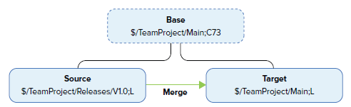
Merging Changes
Merging is the process of moving one or more changes between branches.

Slide 149
Branching and Merging Demo
Create a Branch
Merge changes
Show visualized history
Branch Hierarchies
Tracked Changeset
Hierarchy
Timeline

Slide 150

Question

